Slide 1
Sleep- Disorder Prediction Based on Symptoms
-Vipul Purohit

Slide 2
TABLE OF CONTENT
Description
Project Key Points
-Problem Statement
-Objective
Model Building
Evaluation Matrix Table
Conclusion

Slide 3
DESCRIPTION
Sleep disorders affect a significant portion of the population worldwide, impacting overall health, productivity, and quality of life. Early detection and intervention are crucial for managing these disorders effectively. Machine learning (ML) algorithms offer a promising approach to predict sleep disorders based on various data sources, including physiological signals, sleep patterns, and lifestyle factors.

Slide 4
PROJECT KEY POINTS
Problem Statement :
Developing a machine learning model to predict sleep disorders based on physiological and behavioural data, aiming to assist in early detection and intervention for better sleep health outcomes
Objective:
Objective of this project is to develop a machine learning model capable of accurately predicting sleep disorders based on relevant physiological and behavioural data, aiming to improve early detection and intervention for individuals at risk.

Slide 5
MODEL BUILDING
1
Define The Problem
2
Gather & Prepare Data
Gather Relevant Data & Clean the data – Handling missing values, Remove duplicates & Outliers
3
Exploratory Data Analysis (EDA)
Analyse the data to gain insights into its distribution, relationships, and patterns.
Goal of your project & What are you try to predict or Classify
Feature Scaling
Normalization/ Standardization the data & Transform Distribution of data
4

Slide 6
5
6
Model Selection
7
Model Training
Train the selected model on the training dataset using appropriate algorithm.
Data Splitting
Define X, Y variable. Divide the dataset into training, validation, and testing sets
Choose an appropriate machine learning algorithm or model architecture based on the nature of the problem(Regression/ Classification)
8
Model Evaluation
9
Model Tuning
Fine-tune the model by adjusting hyperparameters using Grid Search CV, Randomized search CV
10
Model Interpretation
Try to interpret its predictions to gain insights into the underlying patterns and decision-making process..
Evaluate the trained model's performance on the testing dataset using suitable evaluation metrics (accuracy, precision, recall, F1-score, etc.)

Slide 7
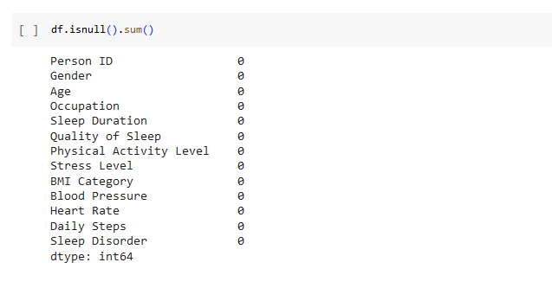

DATA PREPROCESSING
To Check Null Value & Duplicates in Dataset
Data Preprocessing consist of Data Cleaning-Handling Missing Values, Removing duplicates, Detection & Removing Outliers

Slide 8
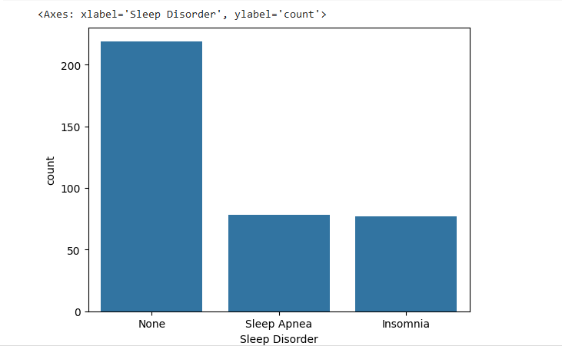
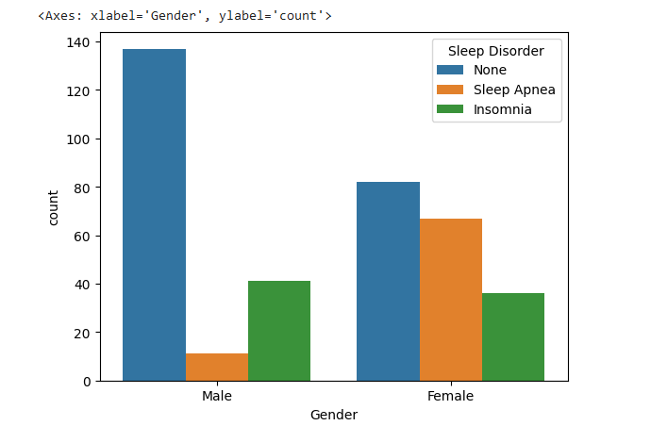
Data Visualization

Slide 9
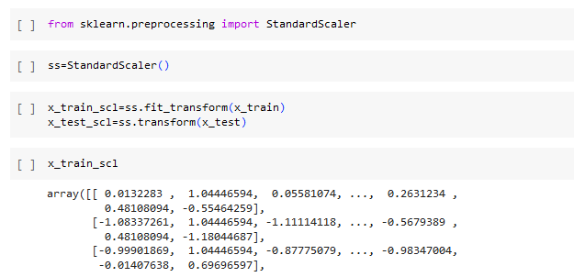
Feature Scaling Standardization scaling is a data pre-processing technique used in statistics and machine learning to transform numerical features by subtracting the mean and dividing by the standard deviation where mean = 0 & Standard Deviation = 1

Slide 10
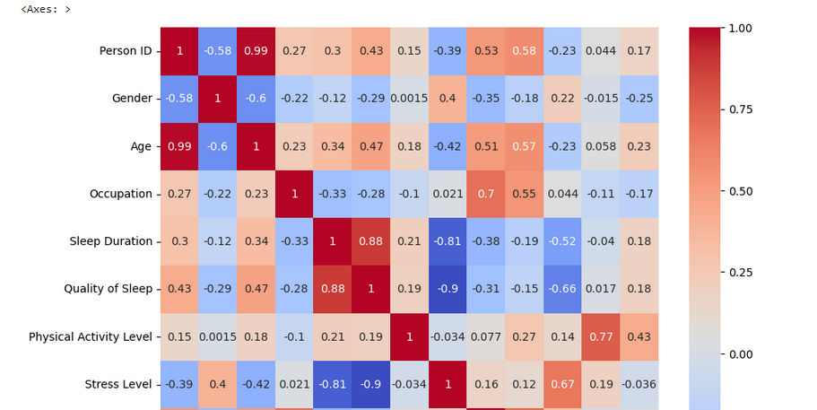
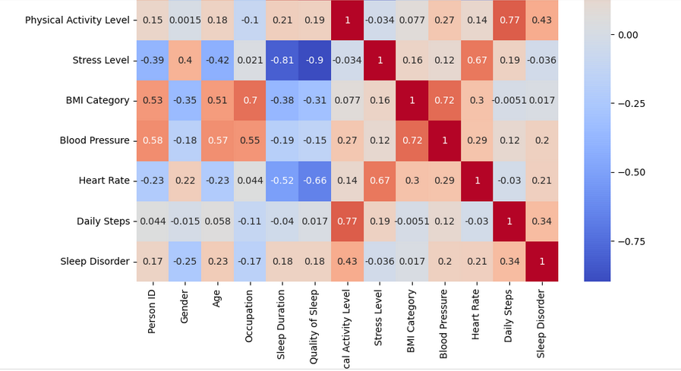
Heatmap Correlation- To check relation with Target Variable

Slide 11
Evaluation Matrix Table
ALGORITHMS | ACCURACY
Random Forest (Tuned with Grid search CV) | 94.61%
Support vector Machine (Tuned with Grid search CV) | 93.46%
Logistic Regression(Tuned with Grid search CV) | 92.50%
Decision Tree Classifier | 92.00%
Support Vector Machine | 92.00%
Logistic Regression | 91.00%
Gradient Boosting | 90.66%
Xtreme Gradient Boosting | 90.66%
Random Forest Classifier | 88.00%

Slide 12
CONCLUSION
By leveraging machine learning techniques to predict sleep disorders based on reported symptoms, from this project achieved a high accuracy rate of 94.61% for the Random Forest algorithm after optimizing parameters using Grid search CV which aims to assist healthcare professionals in early identification and intervention, ultimately improving the management and treatment of sleep-related conditions.

Slide 13
THANK YOU.

